Slide 1

Graph Coloring Problem: (Greedy Approach)
Name: Arya Rohan Rachamalla.
Reg no: 3122256002002.
Topic: Graph Coloring problem

Slide 2

What is Graph Coloring?
Graph coloring is a fundamental problem in graph theory where we assign colors to vertices of a graph following a simple but powerful constraint: no two adjacent vertices can share the same color.
The ultimate goal is to achieve a proper coloring using the minimum number of colors possible, known as the graph's chromatic number.
Scheduling Problems
Register Allocation
Channel Assignment
Organizing tasks and events without conflicts
Optimizing compiler memory usage efficiently
Distributing frequencies to minimize interference

Slide 3
Why Graph Coloring Matters
Graph coloring transforms complex real-world scheduling challenges into elegant mathematical solutions. Let's explore a classic application that demonstrates its practical power.
The Challenge
The Model
The Solution
Universities must schedule hundreds of exams ensuring no student has conflicting exam times
Each exam becomes a vertex, conflicts create edges between vertices, and colors represent time slots
Proper coloring guarantees a conflict-free schedule using the minimum number of time periods

Slide 4


The Greedy Coloring Algorithm: Overview
01
Select Vertex Order
Choose a sequence for processing all vertices in the graph
02
Examine Neighbors
For each vertex, identify colors already used by adjacent vertices
03
Assign Smallest Available Color
Select the lowest-numbered color not used by any neighbor
04
Repeat Until Complete
Continue process until all vertices are colored
Key Insight: The greedy approach is simple and fast, making it practical for large graphs. However, it doesn't guarantee finding the optimal minimum number of colors.

Slide 5
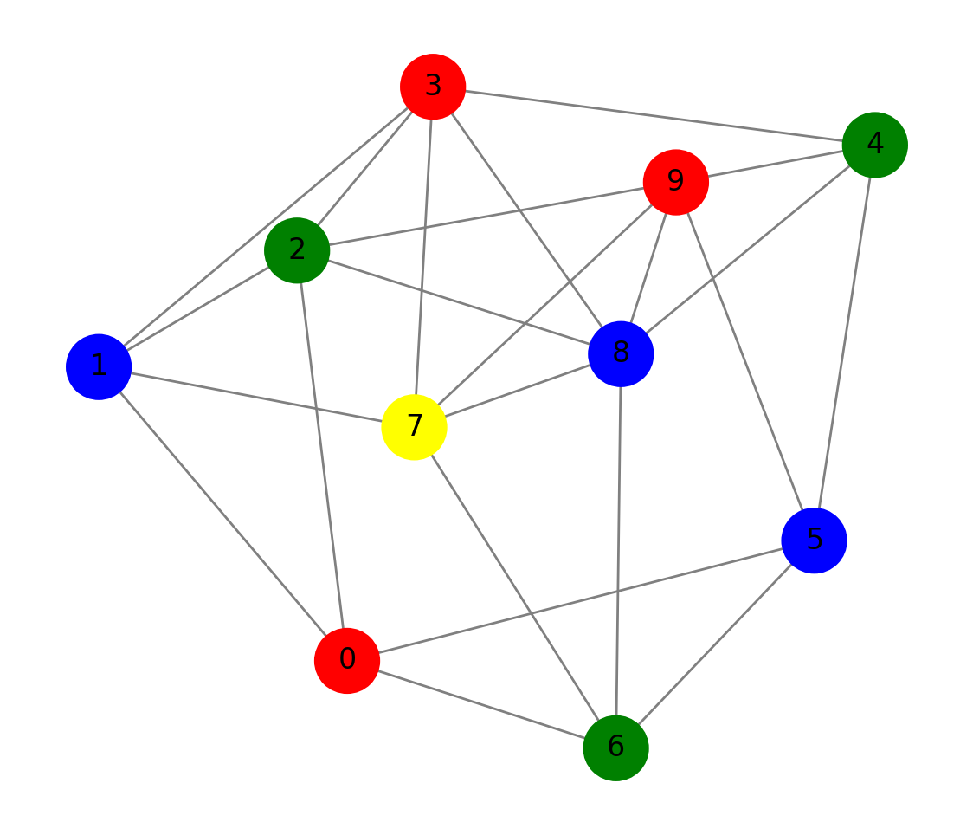
Visualizing the Example

Slide 6


Code Snippet
# Greedy Graph Coloring
def greedy_coloring(graph):
# Store colors assigned to vertices
color_assignment = {}
# Go through each vertex one by one
for vertex in graph:
# Step 1: Find colors of adjacent vertices
used_colors = []
for neighbor in graph[vertex]:
if neighbor in color_assignment:
used_colors.append(color_assignment[neighbor])
used_colors = set(used_colors) # Remove duplicates
# Step 2: Assign the smallest available color
color = 0
while color in used_colors:
color += 1
color_assignment[vertex] = color
return color_assignment
# Example graph as adjacency list
graph = {
0: [1, 2],
1: [0, 2, 3],
2: [0, 1, 3],
3: [1, 2]
}
colors = greedy_coloring(graph)
# Display results
print("Vertex : Assigned Color")
for vertex, color in colors.items():
print(f"{vertex} ---> {color}")

Slide 7
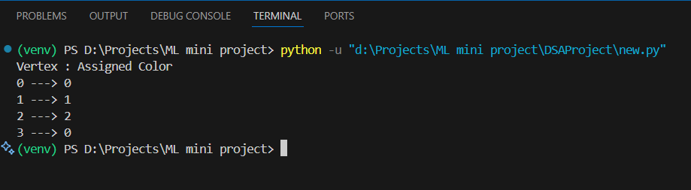
Output

Slide 8
Algorithm Complexity & Guarantees
Performance Analysis
The greedy coloring algorithm offers excellent computational efficiency, though its results depend critically on implementation choices.
Time Complexity: O(V^2) where V represents the number of vertices and E represents the number of edges in the graph. For Neive Approach it is O(k^n)
For sparse graphs with efficient data structures, this can be optimized further to near-linear time.

Slide 9

Limitations of Greedy Approach
While the greedy algorithm is intuitive and efficient, it comes with important limitations that practitioners must understand.
No Optimality Guarantee
Order Sensitivity
Worst-Case Scenarios
The greedy approach does not always find the minimum number of colors (chromatic number) needed to properly color a graph. It provides a good solution, but not necessarily the best possible solution.
Processing the same graph's vertices in different orders can yield dramatically different results, potentially using anywhere from the optimal number to significantly more colors.
Certain graph structures and vertex orderings can cause the greedy algorithm to perform poorly, using far more colors than necessary for an optimal coloring.
Example: A cycle graph with 5 vertices has a chromatic number of 3, but poor vertex ordering in greedy coloring could require 4 or even 5 colors.

Slide 10

Summary & Takeaways
Intuitive Yet Powerful
Greedy coloring provides an intuitive and efficient heuristic for solving graph coloring problems, making it accessible for implementation while delivering reasonable results quickly.
Practical Applications
Despite not guaranteeing optimality, the algorithm is useful in many real-world scenarios from exam scheduling to register allocation, where good-enough solutions are valuable.
Order Matters
Vertex processing order is crucial to results—smarter ordering strategies like Welsh-Powell significantly improve performance without adding substantial complexity.
Room for Growth
For complex graphs requiring optimal solutions, explore advanced heuristics and exact algorithms such as backtracking, branch-and-bound, or metaheuristic approaches.

